Slide 1
Revolutionzing coustomer support with an intelligent chat bot for automate assistance
Name: dhivyasri.D
Register number: 422223106011
Department: ECE
College: Surya group of institutions
Submission date:6/05/2025
Getup link:https://github.com/dhivyasri123/Revolutionzing-coustomer-support-with-an-intelligent-chat-bot-

Slide 2
Problem Statement
In the current digital era, businesses face challenges in delivering fast, efficient, and consistent customer support due to increasing customer demands, limited human resources, and operational costs. Traditional customer support systems are often slow, resource-intensive, and struggle to handle high query volumes, leading to customer dissatisfaction and loss of trust.
To address this, our project focuses on developing an intelligent chatbot capable of understanding and responding to customer queries in real time using Natural Language Processing (NLP) and Machine Learning (ML) techniques. By automating common support tasks and providing instant responses, the chatbot significantly enhances user experience while reducing the burden on human agents.

Slide 3
Objective
The objective of this project is to design and develop an intelligent chatbot system that automates customer support services by using Natural Language Processing (NLP) and Machine Learning techniques. The chatbot aims to provide instant, accurate, and 24/7 assistance to customers, thereby reducing human workload, minimizing response time, and enhancing customer satisfaction.
—

Slide 4
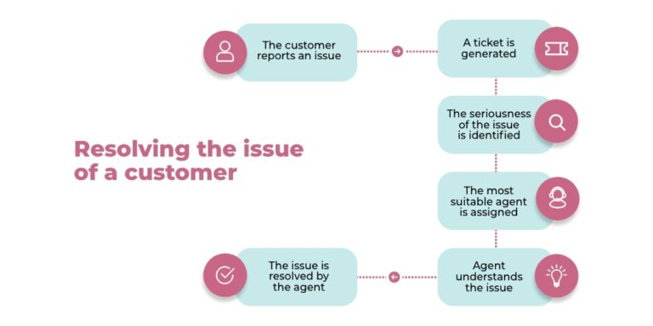
Flow chart of project work flow

Slide 5
Data description
The dataset used in this project is designed to support the development of an intelligent chatbot for customer service automation. It includes various types of data such as customer queries, frequently asked questions (FAQs), and predefined responses. Each query is labeled with a specific intent, such as billing, technical support, or general inquiries. This helps the chatbot understand what the user is asking and respond appropriately. The data may also contain chat histories, which help in training the model to understand real-world conversation patterns. The dataset is usually stored in structured formats like CSV or JSON, making it easy to process. This data forms the foundation for training the machine learning model to understand and respond to customer inputs accurately.

Slide 6
Data processing
To train the chatbot effectively, the raw data is first preprocessed through several steps. Initially, all text data is cleaned by removing punctuation, special characters, and converting text to lowercase for uniformity. Next, tokenization is performed to break sentences into individual words. Common stop words such as "is", "the", and "a" are removed to focus on meaningful terms. The words are then stemmed or lemmatized to reduce them to their root form, improving understanding. After that, the textual data is converted into numerical vectors using techniques like TF-IDF or Bag of Words. User intents are also label-encoded to be used in machine learning models. Finally, the entire dataset is split into training and testing sets to build and validate the chatbot’s performance effectively.

Slide 7
Exploratory Data Analysis (EDA)
In the development of an intelligent chatbot for customer support, Exploratory Data Analysis (EDA) plays a vital role in understanding the nature and quality of the data. Through EDA, we analyze the distribution of different customer query intents such as billing, technical issues, and general inquiries. We use visualizations like bar charts and pie charts to observe how frequently each type of query occurs. Word clouds are generated to identify the most commonly used keywords in customer messages, which helps in improving the chatbot’s understanding of natural language. EDA also helps in spotting issues such as duplicate queries, missing values, or class imbalance, where some types of queries are much more common than others. These insights guide us in refining the dataset, improving the model's accuracy, and ensuring the chatbot provides reliable automated assistance.

Slide 8
Features of engineering
Feature engineering is a key step in improving the performance of the chatbot by transforming raw data into meaningful inputs for machine learning models. In this project, textual features from customer queries are extracted and converted into numerical representations that the model can understand. Techniques such as Bag of Words, TF-IDF (Term Frequency-Inverse Document Frequency), and Word2Vec are used to capture the importance and context of words in each query. Additional features include the length of the message, the number of keywords matched with the FAQ database, and the presence of specific intent-related words. These features help the model better classify user intents and generate accurate responses. By carefully engineering these features, we ensure that the chatbot can understand and process customer queries more effectively.

Slide 9
Model building
In this project, model building involves training a machine learning model that can accurately classify customer queries and generate relevant responses. After preprocessing and feature engineering, the processed data is fed into classification algorithms such as Logistic Regression, Support Vector Machines (SVM), or deep learning models like LSTM (Long Short-Term Memory) for better understanding of context in conversations. The model learns from labeled data to associate customer inputs with specific intents. Hyperparameter tuning is done to optimize model performance. Once trained, the model is evaluated using metrics such as accuracy, precision, recall, and F1-score. The best-performing model is then integrated into the chatbot system to provide real-time, automated customer support.

Slide 10
Visualization of Results & Model Insights
Once the model is trained, it is important to visualize the results to evaluate its performance and gain insights into its behavior. Various techniques are used to visualize how well the chatbot handles different types of queries. For example, confusion matrices help in understanding the classification accuracy, showing the distribution of true positives, false positives, true negatives, and false negatives across different intents. Bar charts and line graphs can display the model’s performance metrics such as accuracy, precision, recall, and F1-score across different epochs or parameter settings. Additionally, feature importance graphs provide insight into which features (e.g., specific words or phrases) had the greatest impact on the model's decision-making process. These visualizations allow us to assess the model's strengths and weaknesses, identify areas for improvement, and ensure it meets the required performance standards for automated customer support

Slide 11
Tools and Technologies Used:
1.Programming Language:
Python: The core programming language used for data processing, machine learning, and model development due to its extensive libraries and community support.
2. Libraries and Frameworks:
Natural Language Toolkit (NLTK): Used for text preprocessing tasks such as tokenization, stopword removal, and stemming.
3.spaCy: A powerful library for advanced NLP tasks, including named entity recognition (NER) and dependency parsing.Scikit-learn: Used for implementing machine learning algorithms, model training, and evaluation.TensorFlow/Keras: For building deep learning models like LSTM (Long Short-Term Memory) for better handling of sequential data and context understanding.
4.Pandas: For data manipulation and cleaning tasks, making it easy to work with datasets in tabular form.Matplotlib/Seaborn: Used for visualizing data and performance metrics such as confusion matrices and accuracy scores.

Slide 12
Team members
Dhivyasri -Introduction & Problem Statement, project Objective
Sandhiya – Data Description, Data Processing, Exploratory Data Analysis
Asifa– Feature Engineering, Model Building
Jayasudha -Result Visualization, Model Insights, Tools & Technologies

